Slide 1

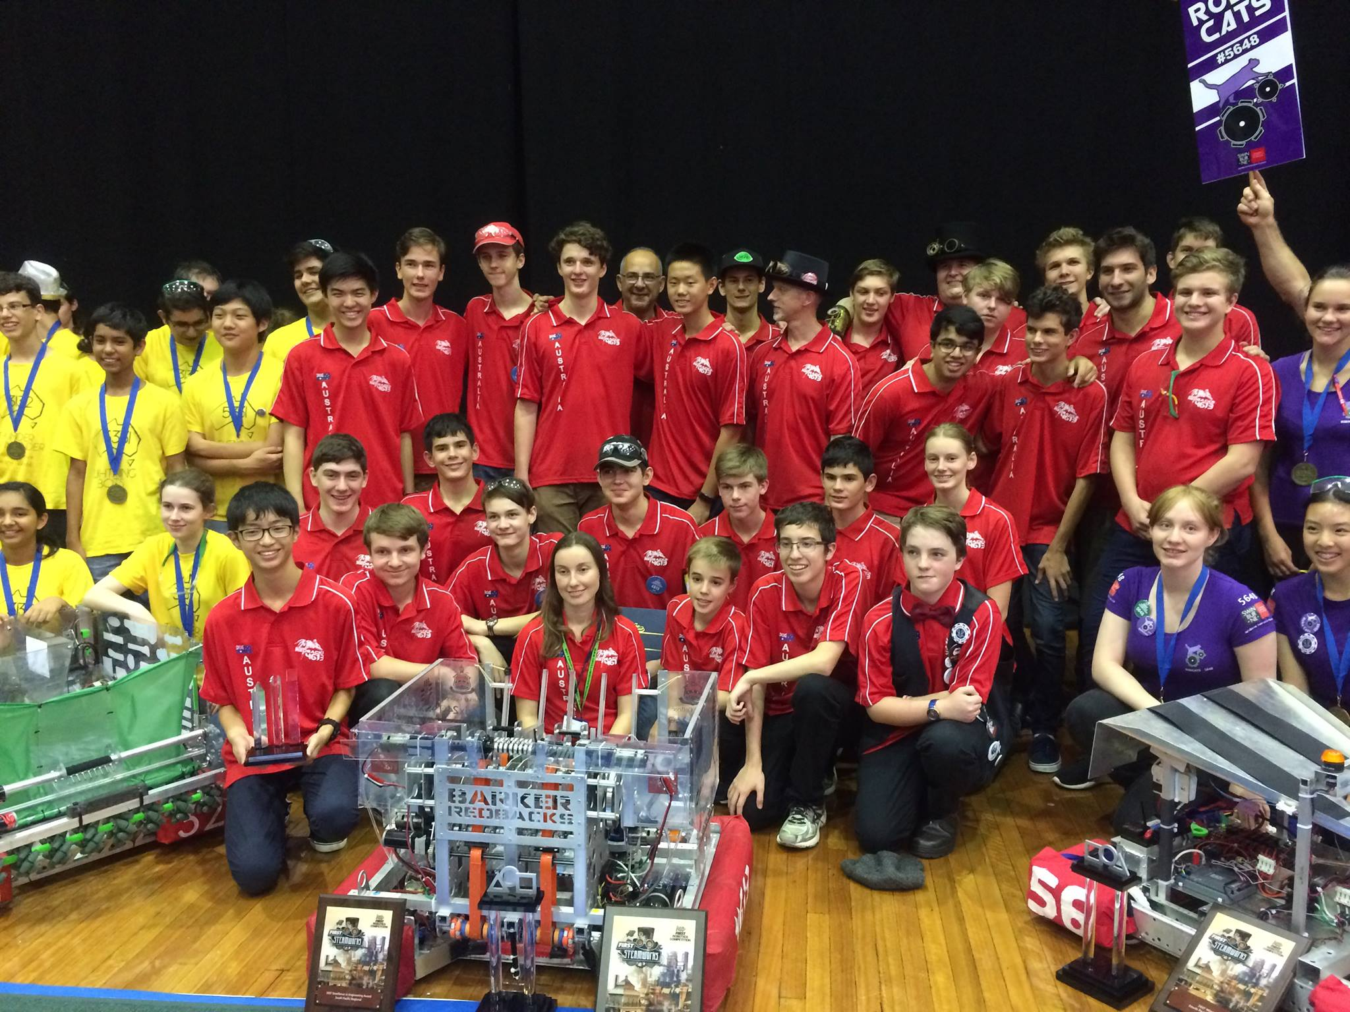
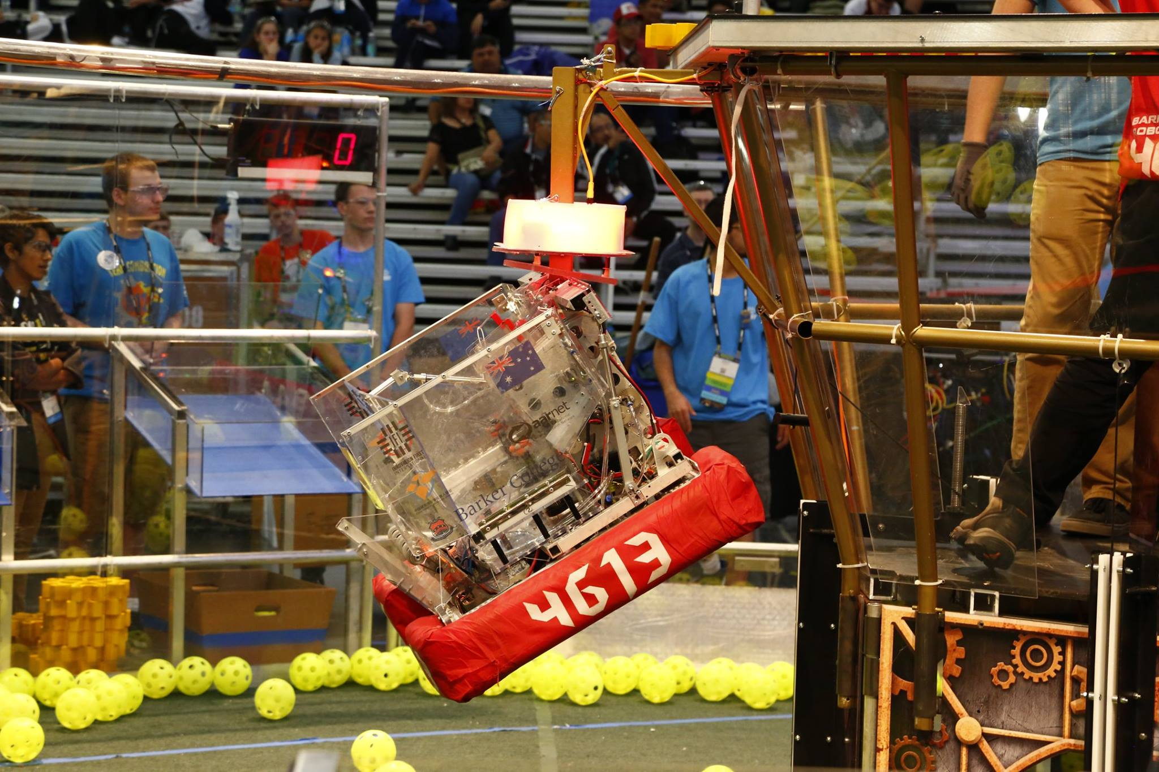
Introduction to (Java) Programming – 2.2 - Variables
Tom Schwarz

Slide 2
Lesson 3: Variables
Variables let you program remember things.
Eg: String teamName = "Barker Redbacks";
This creates a variable called team Name
Variables can be later retrieved:
Eg: System.out.println(teamName);
Variables can even be changed:
Eg: String teamName = "Barker Bluebacks";

Slide 3
Lesson 3: Variables
String teamName = "Barker Redbacks"; _ System.out.println(teamName); _ _ _ _ _ String teamName = "Barker Bluebacks"; System.out.println(teamName); _ _ _ _ _
This would produce:
Barker Redbacks_ Barker Bluebacks
In the console

Slide 4
Lesson 3: Variables
There are many different types of variables. Some common ones are:
Name | Description | Example
int | Stores whole numbers | 1, 5, -8, 4613
float | Stores decimal numbers | 1.2, 8.5, -3.1415926
boolean | Stores true/false value | true, false
String | Stores words/sentences | "I am Mr.Potato", "Bork bork bork", "We are number one"
Note that the capitalisation is important.
Example variable declarations:
int teamNumber = 4613; _ _ _ _ _ _ __ float pi = 3.141592653589793; _ _ _ __ boolean isBorkGod = true; _ _ _ _ _ __ String bestestName = "Dean Borkman"; _

Slide 5
Lesson 3: Variables
Changing variables is easy. It’s the same as declaring the variable, but without the type of it.
int potatoCounter = 2; System.out.println(potatoCounter); potatoCounter = 2 + potatoCounter; System.out.println(potatoCounter);
This would give:
2__ 56_

Slide 6
Lesson 3: Variables
Modifiers change aspects of how variables work.
Modifiers are written before the type.
public static int teamNumber = 4613;
Name | what it does
public | Makes it visible to all other bits of the program (expands its scope).
private | Makes it visible to only the current class (internal to the current file)
protected | Makes it visible to only code in the same file, code in the same package, and any subclasses
static | A big OOP thing. Makes it the same between instances of the object... we'll cover this one later
final | Makes the variable unable to change - also makes it more efficient, and the code run faster.

Slide 7
Lesson 3: Variables
There are many shortcuts to change variable quickly.
You could write: importantNumber = importantNumber + 3;
Or using shortcuts: importantNumber += 3;
Operator | Description
+= | Add amount to variable
-= | Subtract amount to variable
*= | times variable by amount
/= | divide variable by amount
%= | Modulus operator. Divides variable by a number, and sets variable to the remainder. (e.g. 10 % 3 = 1)
++ | Add one to variable (e.g. aNumber++;)
-- | Subtract one to a variable (e.g. aNumber--;)

Slide 8
Lesson 3: Variables
That’s everything! Now do the activities on the guide: https://github.com/Team4613-BarkerRedbacks/Programming-Java-Guide/blob/master/2.Core-elements-of-programs/2.2.Variables.md
On the guide we explain the concept of Scope. It isn’t super necessary, but it is helpful to understand. Try reading through it and understanding the concept, although if you don’t get it don’t worry.

